Slide 1
FridgeMate
Project: 11_00_00
By: KionoKitse
Rev: 1

Slide 2
Home
Suggestions
  What recipe to make
Recipe box
  All recipes
Pantry
  All pantry ingredients
Shopping list
  The shopping list
Receipts
  Scan a receipt or UPC
Search
  Search for a recipe
Menu
  Meal plan for the week
Tools

Slide 3
Suggestions
What recipe to make
Sorted by buildability score
Shows missing ingredients red by category
Shows substitution ingredients in yellow
Filters
  Tags
  Rating
  Time

Slide 4
Recipe Box
View all recipes
Add to menu
Show ingredient status
Filter by tags
Sort by
  Buildability
  Rating
  Name
  Time

Slide 5
Pantry
All pantry ingredients grouped by category
  Produce (Fruit, vegetables, herbs, other), Meat, Dairy, Frozen, Canned, Bakery, Baking, Boxed food, Spices, Others
Mark ingredients as used
Add to shopping list
Sort by
  Name
  Age

Slide 6
Shopping list
Products to buy
Grouped by category (see pantry)
Mark as purchased
Remove from shopping list
Add non-pantry items
Submit items purchased

Slide 7
Receipts
Scan a receipt or UPC
Submit results
Edit results

Slide 8
Search
Search ingredients
  Add ingredient to pantry
  Add ingredient to shopping list
  Search by
    Name, Group
  Sort by name
Search recipes
  Add recipe to menu
  Search by
    Name, Tags, Ingredient
  Sort by
    Buildability, Name, Rating, Time

Slide 9
Menu
List of recipes that planned to be made
Remove recipe from list

Slide 10
Tool Box
Add a recipe
Add an ingredient
Edit last receipt

Slide 11








FridgeMate

Slide 12
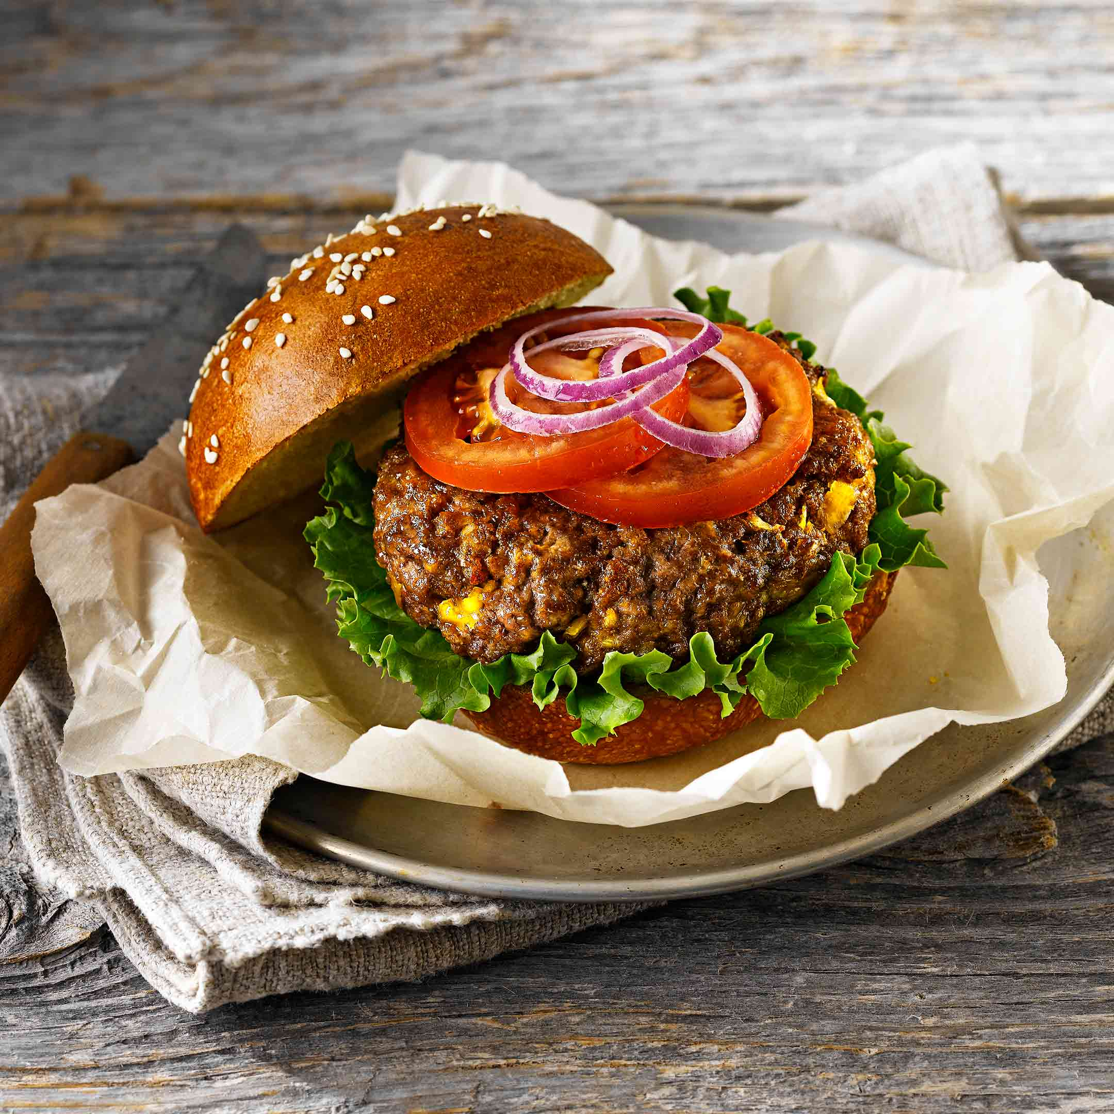
Name

Slide 13
Home
Suggestions
  What recipe to make
Recipe box
  All recipes
Pantry
  All pantry ingredients
Shopping list
  The shopping list
Receipts
  Scan a receipt or UPC
Search
  Search for a recipe
Menu
  Meal plan for the week
Tools

